Slide 1
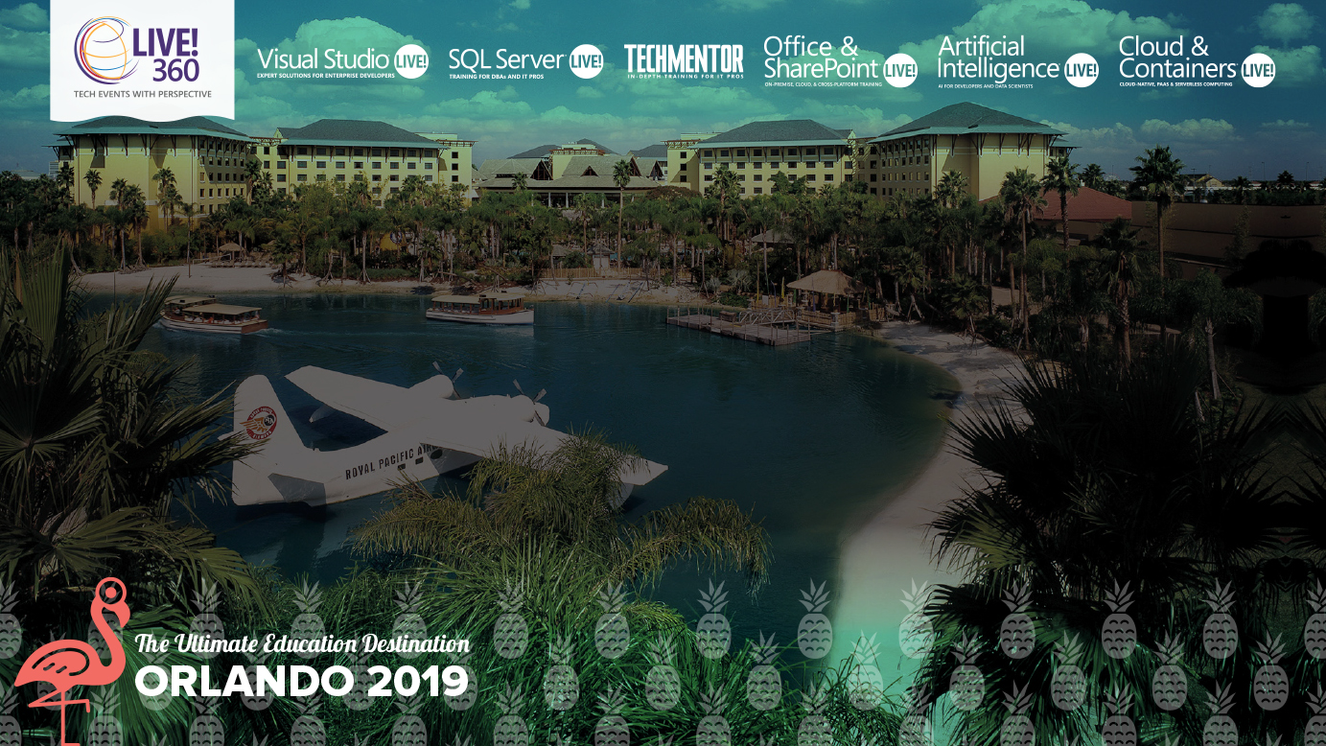
The Edge of Tomorrow
Use Visual Studio Code and Raspberry Pi to Create IoT Edge Solutions
Nicholas McCollum
Sr. Azure FastTrack Engineer,
Microsoft
Level: Intermediate

Slide 2

About Me
Senior Azure FastTrack Engineer at Microsoft
Over 30 years experience developing large scale enterprise applications on client-server, modern web, and cloud platforms
Working on the Azure platform since our original PaaS cloud services offering
MCSA, MCSD, MSCE certified

Slide 3
What is FastTrack for Azure?
FastTrack for Azure is a customer success program for organizations with cloud projects that enables the rapid, effective activations of solutions
It includes tailored guidance from Azure engineers that leverages proven practices and architectural guides
Notes:
microsoft.com/fasttrack

Slide 4
FastTrack for Azure summary
How you benefit
Get direct assistance from Azure Engineers
Learn how to develop successful Azure deployments
Accelerate deployment of Azure solutions
What FastTrack for Azure provides
DEPLOYMENT
Collaboration with your in-house resources and partners to successfully deploy your Azure solutions to production
DISCOVERY
Help defining your business vision and goals and assessing your architectural needs
SOLUTION ENABLEMENT
Proven practices, design principles, and tools for your business applications

Slide 5
Agenda
Edge Computing and Azure IoT Edge
Configure your development environment to build IoT Edge solutions
Turn a Raspberry Pi into an IoT Edge device
Deploy an IoT Edge solution to a Raspberry Pi
IoT Edge devices as transparent gateways

Slide 6
Edge Computing
An increase in IoT devices is producing a massive amount of data to be computed in cloud data centers
Despite improvements in network technology data centers cannot guarantee acceptable transfer rates and response times
Leverage computing infrastructure close to the source of the data to perform tasks and provide services on behalf of the cloud including
Content caching
Service delivery
Storage
IoT management

Slide 7



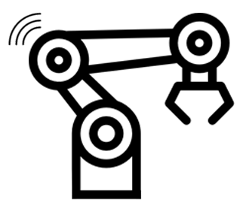

Azure IoT Edge
Move cloud analytics and custom business logic to devices
Package your business logic into containers
Deploy those containers to any of your devices
Monitor from the cloud

Slide 8
Azure IoT Edge Components
IoT Edge Modules
Containers that run Azure services, third-party services, or your own code
Deployed to IoT Edge devices and execute locally on those devices
IoT Edge Runtime
Runs on each IoT Edge device and manages the modules deployed to each device
Cloud-based management and monitoring interface
Remotely monitor and manage IoT Edge devices

Slide 9

IoT Edge Modules
Implemented as Docker compatible containers
Create a pipeline of data processing by configuring multiple modules to communicate with one another
Azure services such as Azure Functions, Azure Stream Analytics, and Azure ML can be run on premises via Azure IoT Edge
Supports Linux and Windows
Supports Java, .Net Core 2.0, Node.js, C, and Python

Slide 10
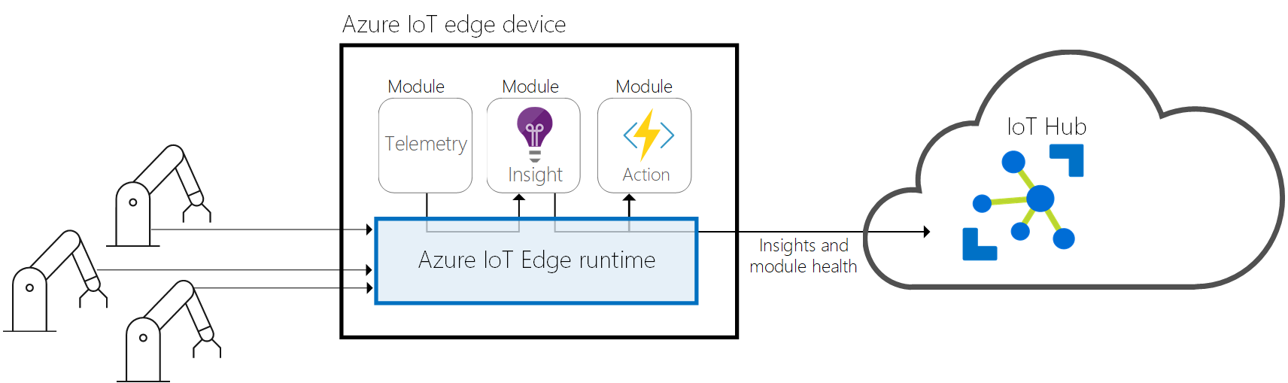

IoT Edge Runtime
Notes:
A collection of programs that turn a device into an IoT Edge device
Enable IoT Edge devices to receive code to run at the edge and communicate the results
Responsibilities are divided between two components
IoT Edge Hub is responsible for communication
IoT Edge Agent deploys and monitors modules
IoT Edge Hub and IoT Edge Agent are deployed as modules in the same manner as any other module running on the IoT Edge device

Slide 11
Cloud-based Management and Monitoring
Provides a single control plane for your solution
Create and configure a workload to be run on a specific type of device
Send a workload to a set of devices
Monitor workloads running on devices in the field

Slide 12

IoT Edge Hub
Acts as a local proxy for IoT Hub
Exposes the same protocol endpoints as IoT Hub
Only supports MQTT and AMQP(s)
HTTP(s) is not supported
Silently delegates some functionality to the IoT Hub
Ex. Initial device authentication
Aggregates logical connections from modules and leaf devices into a single physical connection to the cloud
Acts as a message broker to facilitate module to module communication
Allows modules to remain independent from one another

Slide 13
IoT Edge Agent
Responsible for instantiating modules, ensuring they continue to run, and reporting status of modules to the IoT Hub
IoT Edge security daemon starts the IoT Edge Agent on device startup
Retrieves its module twin from the IoT Hub on startup and inspects the deployment manifest to determine which modules to start

Slide 14
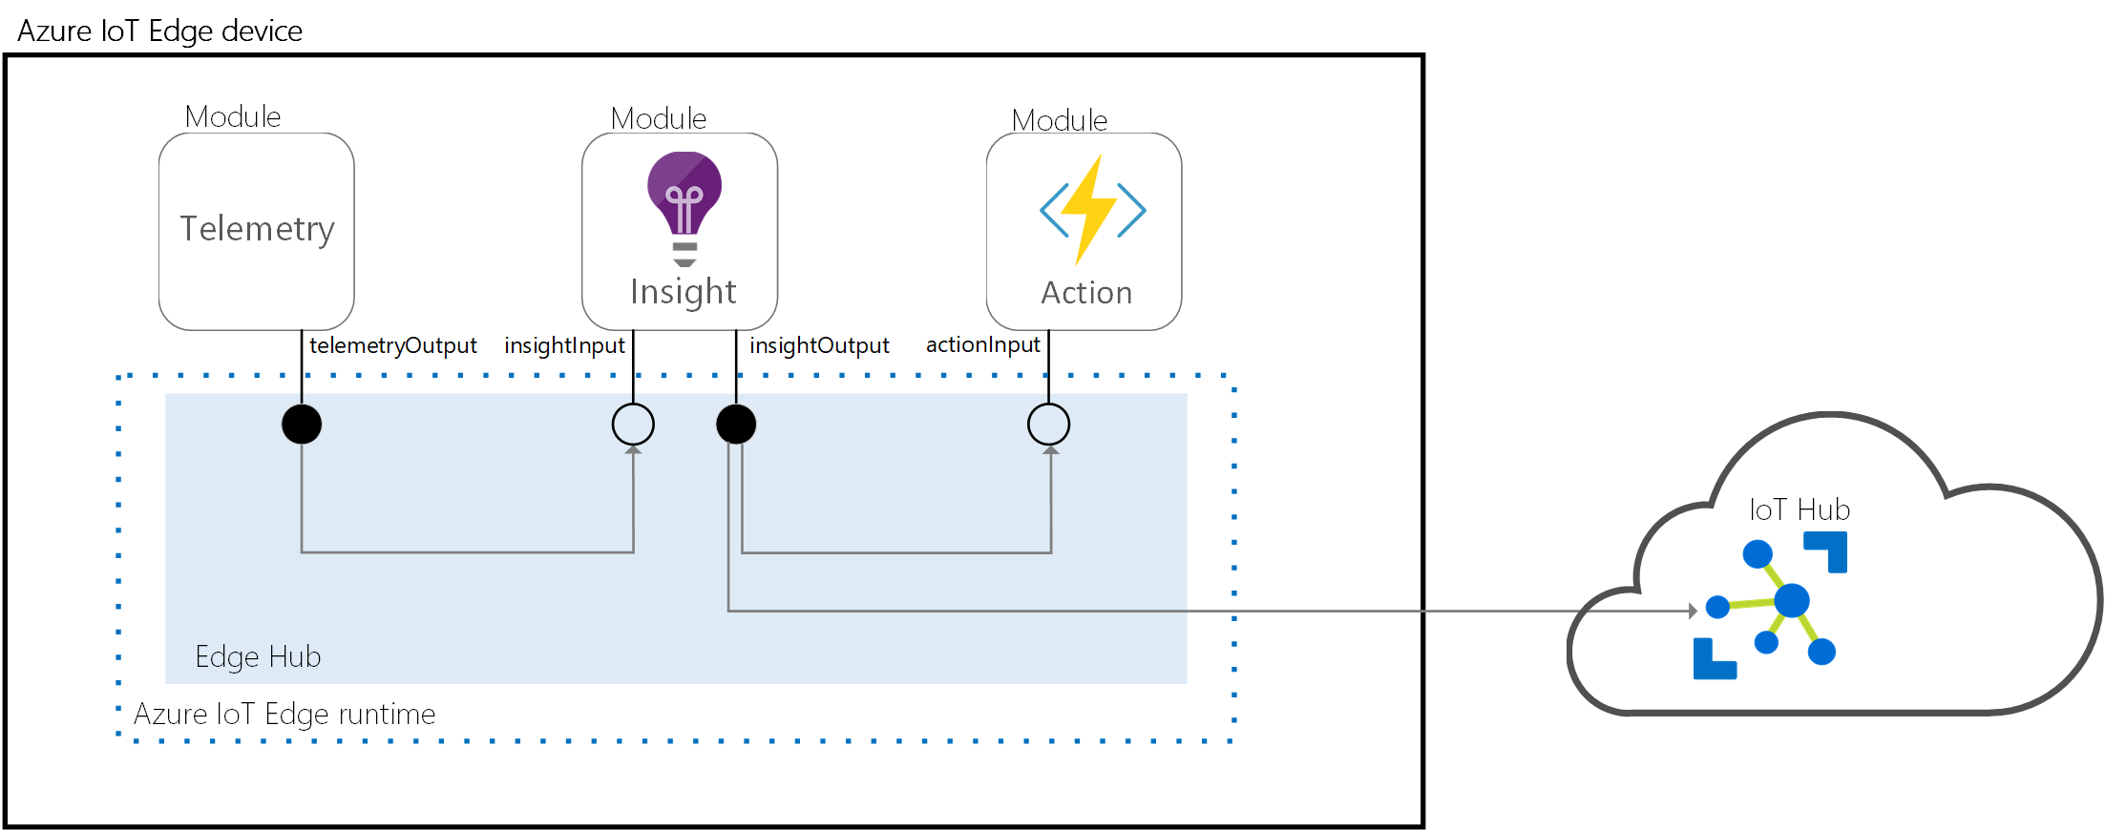
Module Communication
Notes:
IoT Edge Hub acts as a message broker to facilitate module to module communication
Modules only need to specify the inputs they accept messages on and the outputs where they write messages
Allows modules to remain independent of one another
A developer can stitch these inputs and outputs together so modules can process data in an order specific to the solution
Messages routes that specify how messages flow between modules and the IoT Hub are defined in the deployment manifest

Slide 15

Deployment Manifest
All IoT Edge devices must be configured with a deployment manifest
Tells the device which modules to install and how to configure them
A JSON document that describes the IoT Edge Agent module twin and the IoT Edge Hub twin and optionally any additional module twins
In addition to the two runtime modules you can add up to 20 modules of your own to run on the IoT Edge device
Every deployment manifest must include the $edgeAgent and $edgeHub module twins
A deployment manifest that only includes the IoT Edge Runtime ($edgeAgent and $edgeHub) is valid

Slide 16

Demo
Examine an IoT Edge deployment manifest

Slide 17
IoT Edge Agent Module Twin ($edgeAgent)
The properties.desired section of the $edgeAgent module twin includes the following information
The schema version (currently 1.0)
The minimum version of Docker required
Any credentials required to retrieve images from container registries
The IoT Edge modules to be loaded and the location of their container images

Slide 18
IoT Edge Hub Module Twin ($edgeHub)
The properties.desired section of the $edgeHub module twin defines how messages are routed between modules and the upstream IoT Hub
Routes
Include a Source, Condition (optional), and a Sink
The source specifies where messages come from. IoT Edge can route messages from modules or leaf devices
The condition is a where clause used to filter messages based on system properties, application properties, or body properties of the message
The sink defines where messages are sent. Can be the IoT Hub ($upstream) or to a specific input of a specific module
FROM /messages/modules/SimulatedTemperatureSensor/outputs/temperatureOutput INTO BrokeredEndpoint(\"/modules/filtermodule/inputs/input1\")
FROM /messages/modules/filtermodule/outputs/output1 INTO $upstream

Slide 19
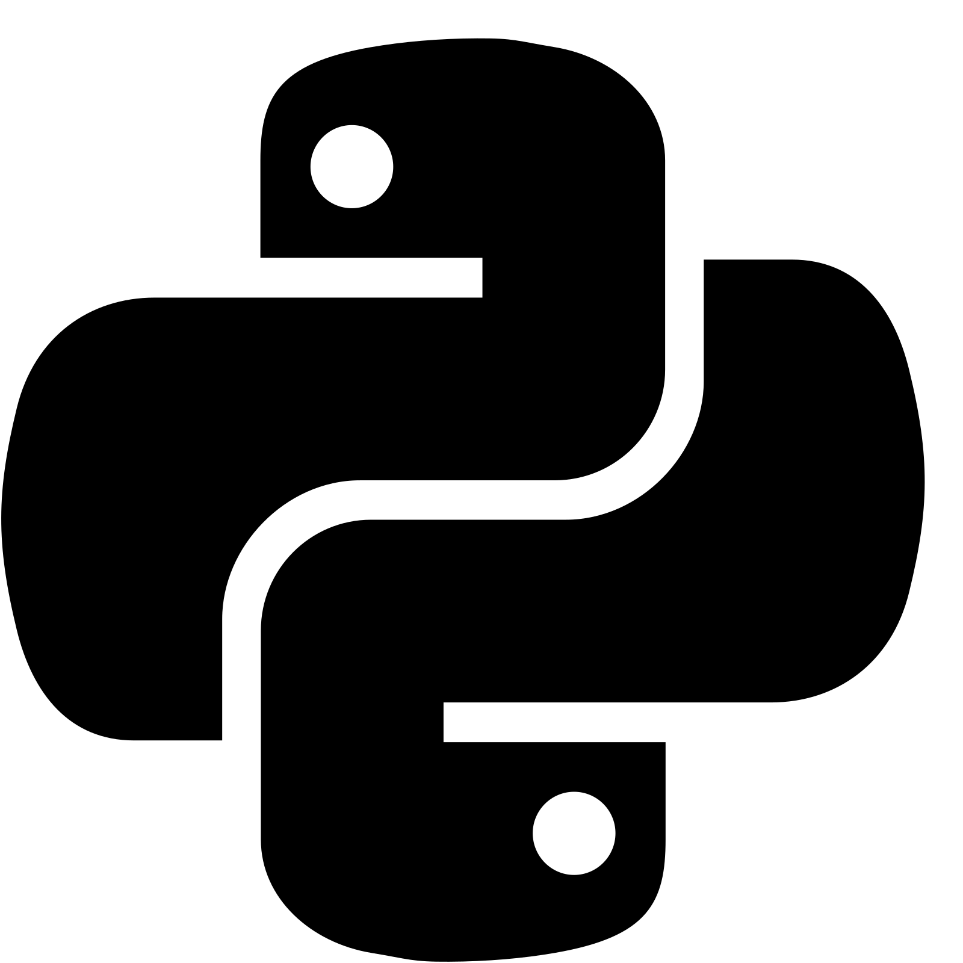

Setup Your IoT Edge Development Environment
Prerequisites
Python 2.7 | 3.5+
.Net Core
Docker *
Visual Studio Code
Install the IoT Edge Simulator
Python 2.7 *
Python 3.5+
pip install --upgrade iotedgehubdev
sudo apt-get install python3-pip
sudo python3 -m pip install --upgrade iotedgehubdev
Notes:
When installing Docker on Linux make sure to add your user id to the docker group (sudo gpasswd -a {username} docker). The IoT Edge extensions for Visual Studio Code will not add sudo before the Docker commands being issued and you will run into access denied errors if you do not add your user id to this group.
Periodically I have run into issues installing the simulator using Python 2.7. I primarily use Python 3 now and I have not had any issues.

Slide 20
Setup Your IoT Edge Development Environment
Install the following extensions in Visual Studio Code
C#
Docker
Azure IoT Tools
Connect to your Azure subscription and IoT Hub from Visual Studio Code
Command Palette… (Ctrl+Shift+P)
Azure: Sign in to Azure Cloud
Azure: Select Subscriptions
Azure IoT Hub: Select IoT Hub
Azure IoT Hub: Set IoT Hub Connection String

Slide 21
Demo
Setup IoT Edge Development Environment

Slide 22
Create Your First IoT Edge Solution
Create a new IoTEdge solution
Command Palette… (Ctrl+Shift+P)
Azure IoT Edge: New IoT Edge Solution
Provide solution name
Select first module type
Provide first module name
Provide your container registry location (default is localhost:5000)
Recommend that you use an Azure Container Registery or Docker registry – not localhost
Azure IoTEdge extension scaffolds your solution and you are ready to begin
Add .env file containing container registery user id and password

Slide 23
Create an IoT Edge Device
Command Palette… (Ctrl+Shift+P)
Azure IoT Edge: Create IoT Edge Device
Provide a device id
The device is created in your IoT Hub
You now have a device you can run the IoT Edge Hub Simulator on
If you will use this device id for a physical IoT Edge device make sure to right-click the device in the Azure IoT Hub Explorer and select Copy Device Connection String, you will need the device connection string to update the config.yaml file on your IoT Edge device

Slide 24

Debug Your First IoT Edge Solution
Debug a single module
Start the IoT Edge Hub Simulator
Command Palette… (Ctrl+Shift+P)
Azure IoT Edge: Start IoT Edge Hub Simulator for Single Module
Put a breakpoint in your module code
Open the VS Code debug pane
Choose {module name} Local Debug for the debugger profile and start the debugger
Stop the debugger when finished
Stop the IoT Edge Hub Simulator
Command Palette… (Ctrl+Shift+P)
Azure IoT Edge: Stop IoT Edge Simulator

Slide 25
Debug Your First IoT Edge Solution
Debug the solution
Start the IoT Edge Hub Simulator
Right-click your device in the Azure IoT Hub Explorer
Choose Setup IoT Edge Simulator to setup the simulator on the device
Command Palette… (Ctrl+Shift+P)
Azure IoT Edge: Build and Run IoT Edge Solution in Simulator
Put a breakpoint in your module code
Open the VS Code debug pane
Choose {module name} Remote Debug for the debugger profile and start the debugger
Select the running module image to attach to it
Stop the debugger when finished
Stop the IoT Edge Hub Simulator
Command Palette… (Ctrl+Shift+P)
Azure IoT Edge: Stop IoT Edge Simulator
Notes:
If you receive a permissions error related to your Docker config file when attempting to debug your solution, execute the following command to change ownership on your Docker config folder
sudo chown "$USER":"$USER" /home/"$USER"/.docker -R

Slide 26

Demo
Create and debug an IoT Edge solution

Slide 27
General IoT Edge Device Setup
Register the Microsoft GPG key and software repository feed
Install the container runtime
Install the Azure IoT Edge Security Daemon
Configure the Security Daemon with your device connection string
Restart the Security Daemon
Check the status of the Security Daemon

Slide 28
Setup Your Ubuntu 18.04 IoT Edge Device
curl https://packages.microsoft.com/config/ubuntu/18.04/multiarch/prod.list > ./microsoft-prod.list
sudo cp ./microsoft-prod.list /etc/apt/sources.list.d/
curl https://packages.microsoft.com/keys/microsoft.asc | gpg --dearmor > microsoft.gpg
sudo cp ./microsoft.gpg /etc/apt/trusted.gpg.d/
sudo apt-get update
sudo apt-get install moby-engine
sudo apt-get update
sudo apt-get install iotedge
sudo nano /etc/iotedge/config.yaml (update the device connection string, save and close the file)
sudo systemctl restart iotedge
systemctl status iotedge
sudo journalctl -u iotedge --no-pager --no-full
sudo iotedge check
sudo iotedge list
Following the last command you should see the edgeAgent module running
It is the only module deployed to the device at this point
Notes:
Make sure to obtain your device connection string from the Azure portal or the Visual Studio Code Azure IoT Hub Explorer so you can update the value in your config.yaml file

Slide 29
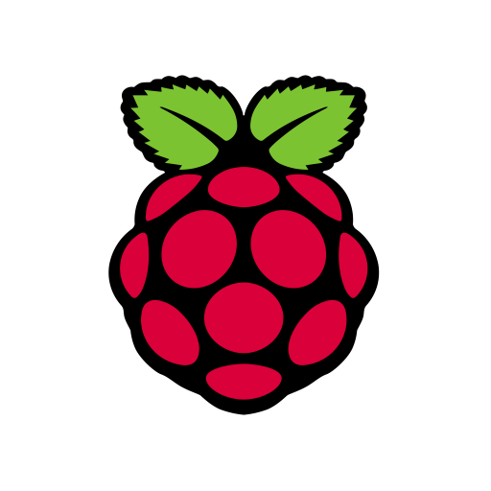
Raspberry Pi Components
Element14 Raspberry Pi 3 B+ Motherboard (https://www.amazon.com/gp/product/B07BDR5PDW)
SanDisk Ultra 32GB Micro SD card (https://www.amazon.com/gp/product/B073JWXGNT)
KuGi Raspberry Pi 3 Model B case PC Protective Case (https://www.amazon.com/gp/product/B01CDVSBPO)
CanaKit 5V 2.5A Raspberry Pi 3 B+ Power Supply (https://www.amazon.com/gp/product/B00MARDJZ4)
Kuman 3.5 Inch TFT LCD Display Monitor with Protective Case (https://www.amazon.com/gp/product/B075JFHLQD) *
iPazzPort Backlit Wireless Mini Keyboard USB (https://www.amazon.com/gp/product/B014F30WYQ) *
* Denotes optional components

Slide 30
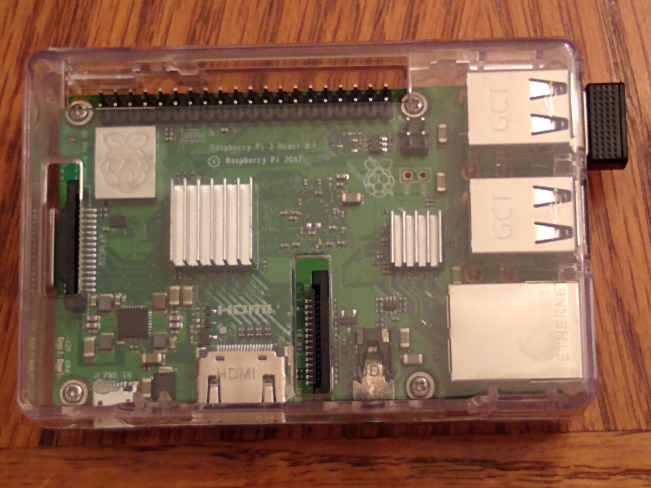
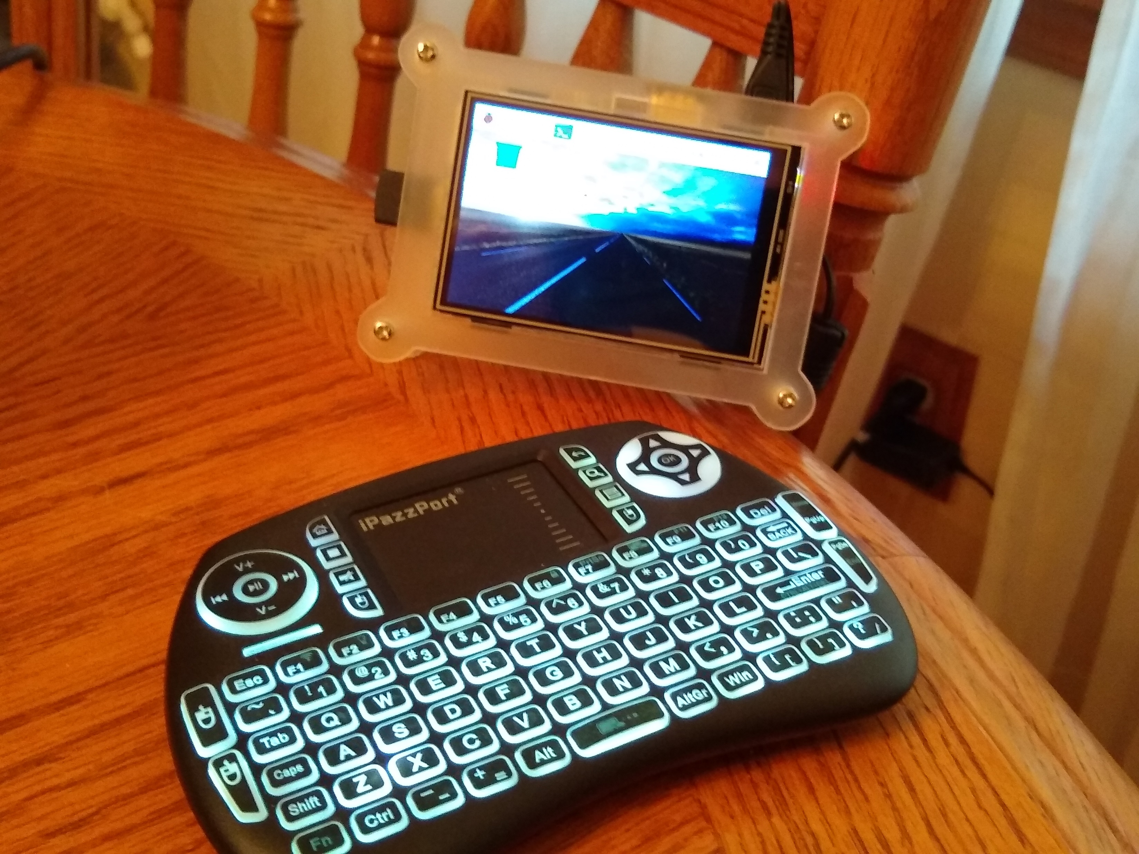
Raspberry Pi Build Out
Assemble your components
Install Raspian with Noobs
https://projects.raspberrypi.org/en/projects/noobs-install

Slide 31
Setup Your Raspberry Pi IoT Edge Device
curl https://packages.microsoft.com/config/debian/stretch/multiarch/prod.list > ./microsoft-prod.list
sudo cp ./microsoft-prod.list /etc/apt/sources.list.d/
curl https://packages.microsoft.com/keys/microsoft.asc | gpg --dearmor > microsoft.gpg
sudo cp ./microsoft.gpg /etc/apt/trusted.gpg.d/
sudo apt-get update
curl -fsSL https://get.docker.com -o get-docker.sh
sh get-docker.sh
sudo usermod -aG docker $USER
sudo apt-get install libssl1.0.2
sudo apt-get update
sudo apt-get install iotedge
sudo nano /etc/iotedge/config.yaml (update the device connection string, save and close the file)
sudo systemctl restart iotedge
systemctl status iotedge
sudo journalctl -u iotedge --no-pager --no-full
sudo iotedge check
sudo iotedge list
Notes:
Make sure to obtain your device connection string from the Azure portal or the Visual Studio Code Azure IoT Hub Explorer so you can update the value in your config.yaml file

Slide 32
Setup Your Raspberry Pi IoT Edge Device
Note that we are using Docker as the container engine on the Raspberry Pi rather than Moby
Moby is the preferred container engine for Azure IoT Edge production deployments
However, the moby-engine package currently has a dependency on the aufs-dkms package which is not supported on Raspian
The docker-ce package no longer has a dependency on aufs-dkms so we are using it on Raspian as our IoT Edge container engine
The Azure IoT Edge Security Daemon will warn you that you are not using the recommended container engine when you run the iotedge check command, but it will still run and execute your modules using Docker

Slide 33
Demo
Setup IoT Edge Devices

Slide 34
Build and Push Your IoT Edge Solution
Build your containers for the appropriate device architecture
Set the device architecture you wish to build for
Command Palette… (Ctrl+Shift+P)
Azure IoT Edge: Set Default Target Platform for Edge Solution
Select your target platform (default on Linux is amd64, for Raspberry Pi select arm32v7)
Push those containers to your container registry
Use the VS Code terminal to login to your container registry
docker login -u {user name} -p {password} {your container registry}
Build and Push your containers
Command Palette… (Ctrl+Shift+P)
Azure IoT Edge: Build and Push IoT Edge Solution
This process will generate a deployment manifest in the config folder for the selected architecture, build the containers, and push them to your container registry
Notes:
If you receive a permissions error related to your Docker config file when attempting to build and push your solution, execute the following command to change ownership on your Docker config folder
sudo chown "$USER":"$USER" /home/"$USER"/.docker -R

Slide 35
Build and Push for Raspberry Pi
Executing the Azure IoT Edge: Build and Push IoT Edge Solution command and selecting the arm32v7 platform will result in an error on a 64-bit Linux OS because cross-platform compilation is not supported at this time
However you still need to run this command to generate the deployment manifest
You will need to build and push the containers from a Raspberry Pi device running Docker

Slide 36
Build and Push for Raspberry Pi
Copy the contents of your modules folder to your Raspberry Pi device running Docker
Execute a docker login command on your Raspberry Pi to authenticate to your container registry
Copy the docker commands that were generated by the Azure IoT Edge: Build and Push IoT Edge Solution from the VS Code terminal window to your Raspberry Pi
Adjust the paths in the commands to match the location where you copied the modules folder to on the Raspberry Pi
Execute the commands to build the containers and push them to your container registry

Slide 37

Demo
Build and Push IoT Edge Solution

Slide 38
Deploy Your IoT Edge Solution to a Device
Select your device
Right-click the device you wish to deploy to in the Azure IoT Hub explorer
Select Create Deployment for Single Device
Select your deployment manifest
On the file explorer dialog drill into the config folder and select the deployment manifest that matches the target architecture of the device you are deploying to
Click the Select Edge Deployment Manifest
Azure IoT Hub deploys the modules identified in the deployment manifest to your IoT Edge device

Slide 39

Monitor Your IoT Edge Solution
The Azure IoT Edge runtime provides a built-in endpoint to allow you to remotely monitor the modules running on the device
Right-click the device you deployed your solution to in the Azure IoT Hub explorer
Select Start Monitoring Built-in Event Endpoint
IoT Edge messages from the remote device will begin streaming into the VS Code output window
When you are done monitoring the device you can select Stop endpoint monitoring in the VS Code notification bar

Slide 40
Demo
Deploy and monitor your IoT Edge solution

Slide 41
IoT Edge Devices as Transparent Gateways
Devices that could theoretically connect to Azure IoT Hub can connect to an IoT Edge device acting as a gateway
These devices are referred to as “leaf” devices and are typically not capable of hosting the IoT Edge runtime
They communicate with IoT Hub using one of the other available SDKs such as the IoT device client SDK
IoT Edge Hub acts as a local proxy for the IoT Hub and exposes the same protocol endpoints as the IoT Hub
Leaf devices can communicate with IoT Hub through the IoT Edge device without being aware they are communicating with the cloud via a gateway

Slide 42
Benefits of IoT Edge Gateways
Analytics at the edge
Process data locally from downstream devices to find and react to insights without sending full-fidelity telemetry to the cloud
Downstream device isolation
Shield all downstream devices from exposure to the internet
Connection multiplexing
Downstream devices connecting to IoT Hub through an IoT Edge device use the same underlying connection
Traffic smoothing
IoT Edge will automatically implement exponential backoff if IoT Hub throttles traffic and will persist messages locally
Offline support
The IoT Edge device will store messages and twin updates that cannot be delivered to the IoT Hub

Slide 43
Configure an IoT Edge Device as a Gateway
Requirements
The gateway device needs to securely connect to downstream devices
Must be able to receive communication from downstream devices
Must be able to route messages to the proper destination
The downstream device cannot be an IoT Edge enabled device
Secure communication is achieved through public key infrastructure (PKI) and X.509 certificates
Open the following ports to allow communication
8883 (MQTT)
5671 (AMQP)
443 (SSL)
Adjust message routes in the deployment manifest to route messages sent from downstream devices
"leafDeviceToGatewayModule":"FROM /messages/* WHERE NOT IS_DEFINED($connectionModuleId) INTO BrokeredEndpoint(\"/modules/gatewaymodule/inputs/input1\")"

Slide 44
Connect a Leaf Device to the IoT Edge Gateway
The leaf device must be registered with IoT Hub and have its own device identity
When registering the leaf device with IoT Hub specify the IoT Edge device as its parent device
Modify the connection string used by the leaf device’s application to connect to IoT Hub to connect to the IoT Edge gateway instead
The GatewayHostName value can be obtained from the config.yaml file on the IoT Edge device
Install the root CA certificate from the IoT Edge device on the leaf device
HostName=myiothub.azure-devices.net;DeviceId=leafDevice;SharedAccessKey=xxxyyyzzz;GatewayHostName=iotedgeGateway

Slide 45

Demo
Using an IoT Edge device as a transparent gateway

Slide 46
Summary
Azure IoT Edge provides a powerful, easy-to-use platform for building edge computing solutions
Visual Studio Code and associated extensions for Azure IoT and Azure IoT Edge provide a comprehensive development environment for building, testing, and deploying Azure IoT Edge solutions
Raspberry Pi offers a great micro computing platform for hosting Azure IoT Edge solutions
Transparent gateways allows IoT leaf devices to leverage Azure IoT Edge devices as gateways to Azure IoT Hub

Slide 47
Content and Samples
https://github.com/nimccoll/Live360IoTEdge

Slide 48
References
What is Edge Computing? (https://www.ge.com/digital/blog/what-edge-computing)
Edge Computing and IoT (https://www.i-scoop.eu/internet-of-things-guide/edge-computing-iot/)
Understand the Azure IoT Edge Runtime (https://docs.microsoft.com/en-us/azure/iot-edge/iot-edge-runtime)
Debug IoT Edge modules with Visual Studio Code (https://docs.microsoft.com/en-us/azure/iot-edge/how-to-vs-code-develop-module)
Install Raspian with Noobs (https://projects.raspberrypi.org/en/projects/noobs-install)

Slide 49
References
Install Docker on Raspberry Pi (https://linuxize.com/post/how-to-install-and-use-docker-on-raspberry-pi/)
Install the IoT Edge Runtime on Linux (https://docs.microsoft.com/en-us/azure/iot-edge/how-to-install-iot-edge-linux)
Build and Deploy An IoT Edge Solution (https://docs.microsoft.com/en-us/azure/iot-edge/tutorial-csharp-module)
Configure an IoT Edge Device as a Transparent Gateway (https://docs.microsoft.com/en-us/azure/iot-edge/how-to-create-transparent-gateway)

